Slide 1
UVM Testbench Architecture
ECE260C
end of Wk 9
Lab 4 material

Slide 2
UVM references
1. verificationacademy.com (Mentor/Siemens)
2. asic-world.com (structured SystemVerilog testbenches, no UVM)
3. chipverify.com/uvm

Slide 3
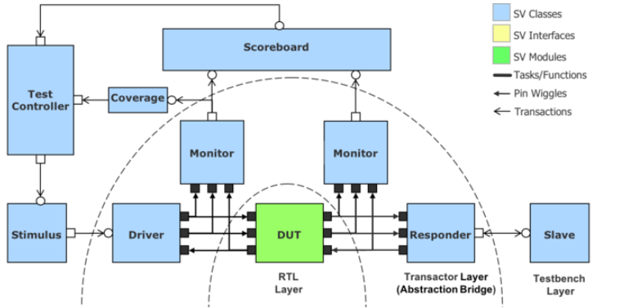
UVM Testbench Architecture
Stimulus =
generator =sequencer
Classes are dynamic
Interfaces are static
Transactors can be subdivided (next slide)
"Pin Wiggles" are clocked/timed; "Transactions" are not

Slide 4
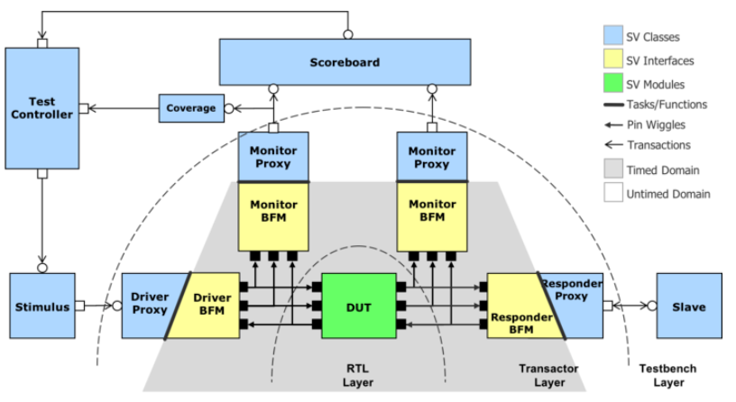
Interfaces Bridge Timed/Untimed Domains
relates to embedded, as well -- think of host RISC processor, even w/ RTOS, and hardware accelerator
Bring SV or, preferably, UVM classes into transaction layer for portability

Slide 5
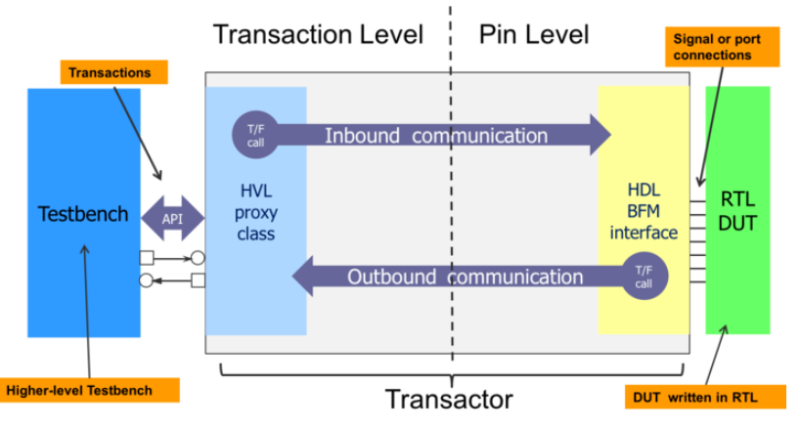
Bridging the Timed/Untimed Domains
"Dual Top" partitioned testbench architecture. (Timed signals in HDL domain, transaction level signals in HVL proxy class.)
T/F = task/function
HVL = hardware verification language
HDL = hardware design language

Slide 6
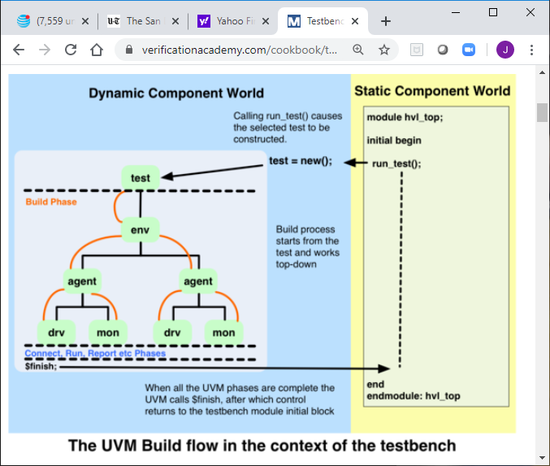
Build Phase
construct uvm_component classes into objects (top-down)
initial run_test("abc") in HVL top module
string argument abc calls test to be run by name, constructs it in UVM factory
UVM starts build method of test class

Slide 7
Test Base Class
derive all tests from this
test class build method:
  factory overrides: config. or component objects are of respective desired type
  create & configure objects for subcomponents
  assign virtual interface handles
  build env config object & include it
  build top-level env into hierarchy
for a discussion of environments and separation of structure from function, see Salemi Ch. 13

Slide 8
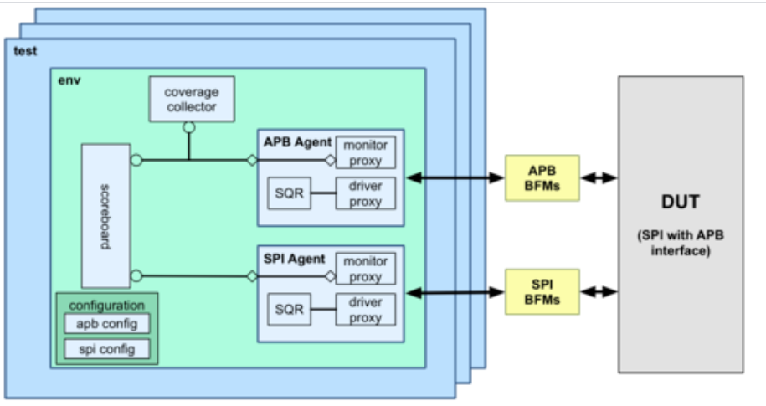
One Device, Multiple Tests

Slide 9

What Is an Agent?

Slide 10
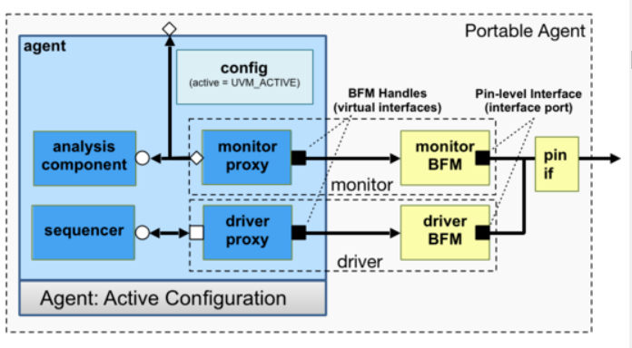
What Is an Agent?
verification component ensemble for a given interface
SV interface (bundle of signals)
monitor BFM driver BFM
SV package of classes (blue)

